Slide 1
Business Driver Impact Modelling
André Oliveira

Slide 2
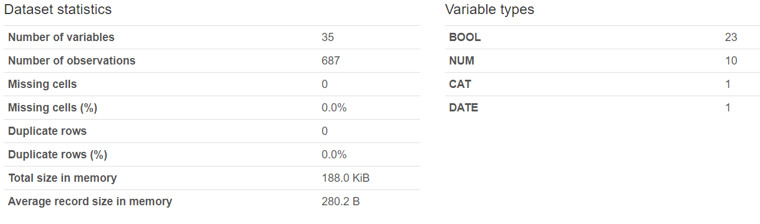
Scope
Analyze and model the relationship between the drivers and the number of product units sold in one of ASOS’s key markets.
Data is based on the number of units sold in the market between January 2019 and November 2020, as well as information about various potential drivers of the market during the said period.
Forecast the expected number of units to be sold in the near future, guiding short-term business decisions.

Slide 3
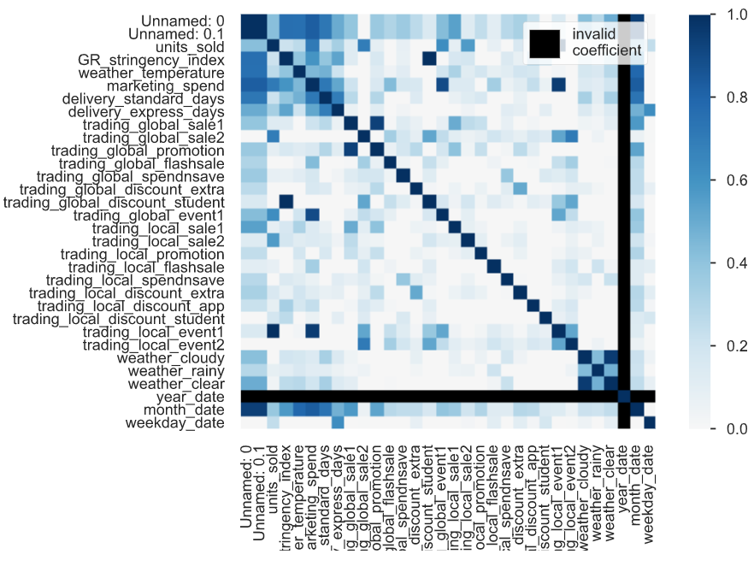
Exploratory Data Analysis
Phik’s Correlation
Correlation
When analyzing the Pearson’s correlation, it is visible that there is not much linear correlation between the units sold and the other variables.
When analyzing the Phik’s correlation – a measure suitable for categorical, ordinal and interval variables that captures non-linear dependency – it is visible that the number of units sold is very much correlated with the trading events and sales (globally and locally), as well as the marketing spend.

Slide 4
Exploratory Data Analysis
Main Drivers of Units Sold
The final list of relevant features to forecast the number of units sold is based on the correlation and causality checks:
trading events (globally and locally).
trading sales (globally and locally).
trading promotions (globally).
trading flash sales (globally).
trading student discounts (globally and locally).
marketing spend.
GR stringency index.
delivery standard days.
delivery express days.
Causality
When analyzing analyzing the causality results, it is legitimate to infer that the following variables impact the units sold:
trading events (globally and locally).
trading sales (locally).
trading promotions (globally).
trading flash sales (globally).
trading student discounts (globally and locally).
marketing spend.
GR stringency index.
delivery standard days.
delivery express days.

Slide 5
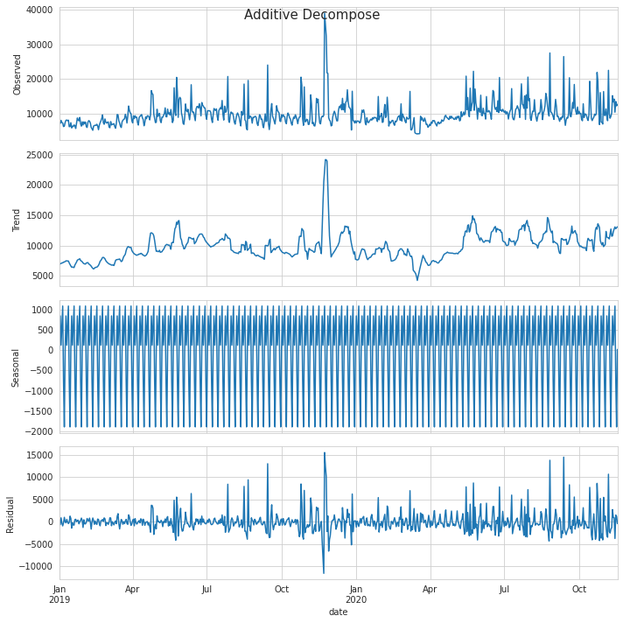
Exploratory Data Analysis
Units Sold – Seasonal Decomposition
Seasonal Decomposition
When analyzing the seasonal decomposition output, related to the units sold and its main drivers, the following assumptions can be made:
Units sold has some seasonality and trend.
The marketing spend has high impact on the units sold, as there is high variability on sold items when the spent amounts increase and increase much.
The first Covid-19 lockdown has generated a massive decrease on market spend and a high increase on the time to deliver orders.
Trading events, sales, promotion, flash sales and discounts have some impact on the units sold, increasing when they occur.
Even though Covid-19 impact has been quite high since the first lockdown (March 2020), the volume of sold items has recovered due to the increase of the funds spent on marketing after the summer.

Slide 6
Methodology
Approach
As the correlation analysis has shown that there is not much linear dependency between features and the stationarity checks revealed that not all features are stationary, the multivariate forecast approach using VAR was ruled out as it would require more data processing and its performance would be questionable.
For this purpose, the selected model was Long short-term memory (LSTM). It is an artificial recurrent neural network (RNN) architecture used in the field of deep learning. Unlike standard feedforward neural networks, LSTM has feedback connections. A common LSTM unit is composed of a cell, an input gate, an output gate and a forget gate. The cell remembers values over arbitrary time intervals and the three gates regulate the flow of information into and out of the cell.
The goal was to predict the next 30 days of units sold using the last 90 days of data.
The dataset was split in 90/30 days chunks of data, each with 2 subsets to avoid data leakage:
Train – used to train the model.
Test – used to evaluate the model.
The main evaluation metric was the Mean Absolute Error.

Slide 7
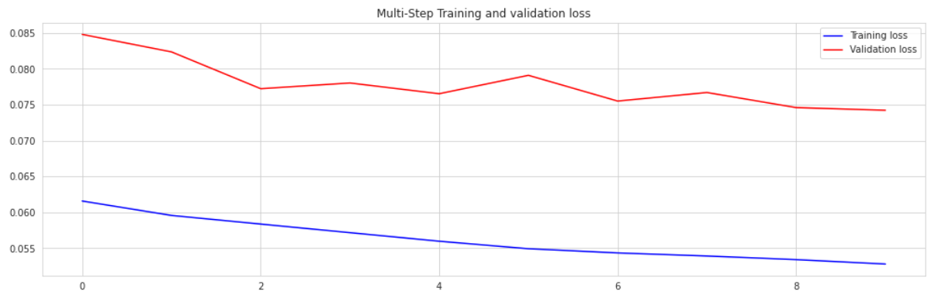
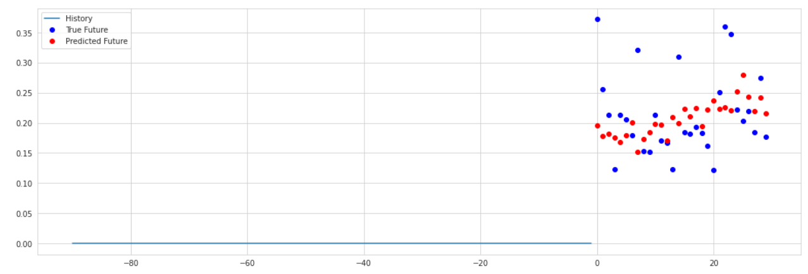
Results
The overall mean absolute error results (normalized) are reasonably good, enough to deem the model as acceptable.
However, the model is not predicting the high variations of units sold perfectly.
In order to improve the model, more data needs to be added and the architecture can be changed (combining LSTM with CNN).

